Slide 1

KNOCK-KNOCK
A deep learning powered door camera
Steven Leung
Juan Ramirez
Javed Roshan
W251 Final Project Presentation

Slide 2
Why Knock-Knock?
The door camera market size reached $1.83B in 2020 (16% US households)¹
Knock-knock is a novel door camera that recognizes common personnel at the door and notifies user:
Facial Recognition to identify known individuals
Full body recognition to identify delivery vs non-delivery personnel

Slide 3
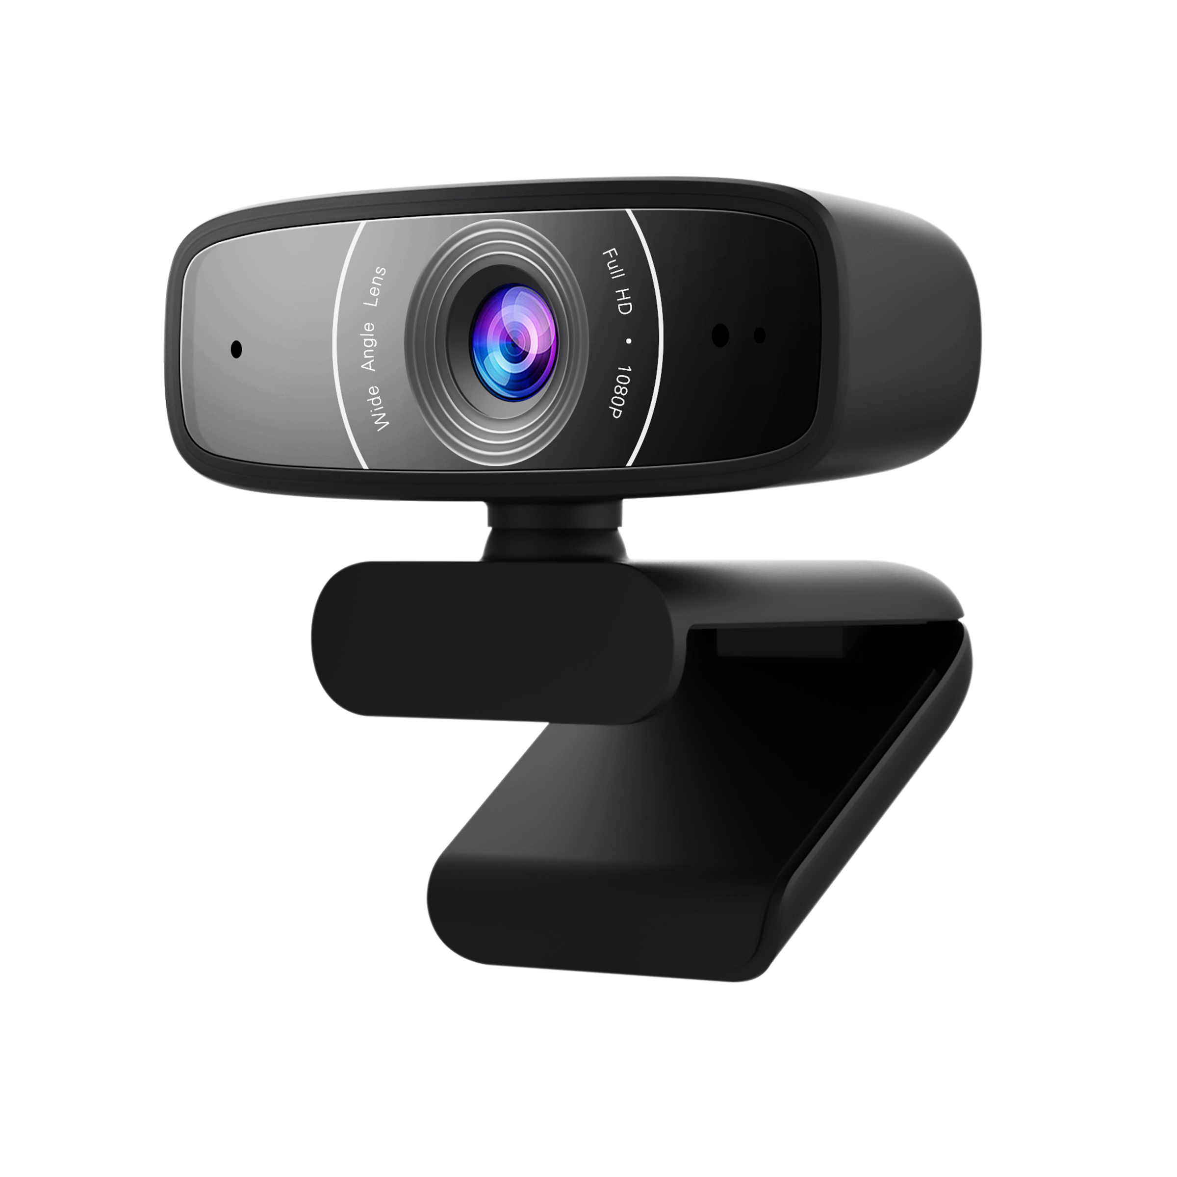
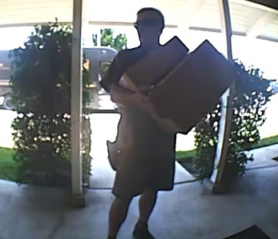
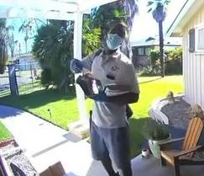


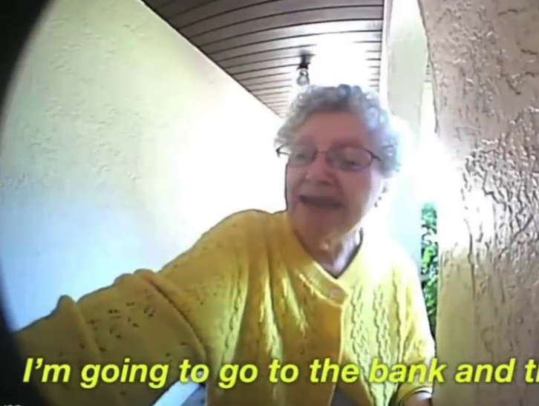
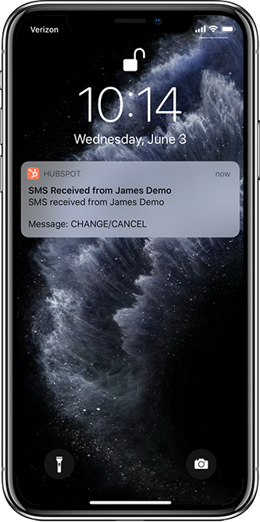
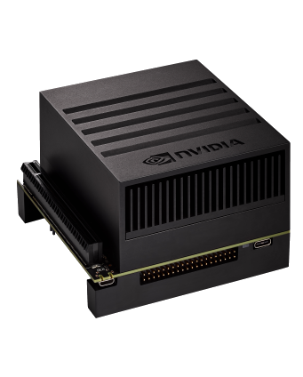
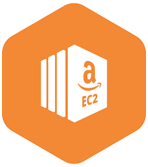
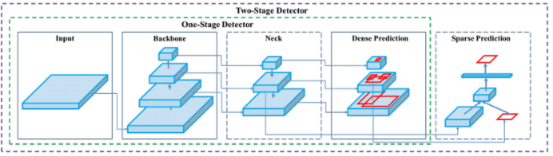
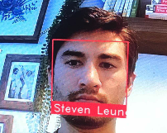
Data Pipeline
Video Stream
Image Collection Youtube to Images
Annotation Deep Lab Segmentation
Person Recognition
Fine tune Yolov5
Personnel Recognition
Jetson Xavier NX
SMS Notification
Facial Recognition
Facial Recognition
Dlib Face-Recognition

Slide 4
Automated Annotations- DeepLab Segmentation
We used search query and deeplab segmentation to automatically annotate 10k images from youtube videos
IMAGE of segmentation process here

Slide 5
Fine Tuning Yolov5
High level of Yolov5 and cnn’s
IMAGE of CNN or Yolov5 architecture here
https://medium.com/axinc-ai/yolov5-the-latest-model-for-object-detection-b13320ec516b

Slide 6
Dlib Face-Recogntion
High level of Dlib face rec

Slide 7
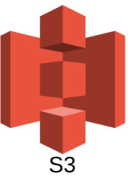
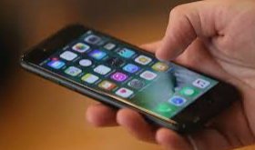
Inference Side
For continuous Training
Image conversion
Mention K8s
More MQTT details
Face detector
Delivery model
Notification (single topic)
SMS

Slide 8
Model Performance
Yolo metrics on test

Slide 9
Knock-Knock in Action
Demo video here

Slide 10
Challenges
Getting good data and tags
Timing and lag
Notification logic
Containers and Kubernetes (getting right environments for each component)

Slide 11
Next Steps
Continuous Training and Evaluation
Archiving faces to recognition repeat visitors
Other types of personnel
Include vehicle
Package thieves
Combining with amazon schedule
Summarization of actions at the door

Slide 12
To do’s (remove slide)
High level: what it is, why it matters
Model Diagram
Data collection, segmentation
Papers to reference
Details on Yolo v5, face rec model
Training details: metrics (compare to others)
Papers to ref
Jetson side diagram
Demo
Challenges
Next Steps

Slide 13
Sources
https://www.grandviewresearch.com/industry-analysis/doorbell-camera-market
https://www.cnet.com/home/security/best-facial-recognition-security-cameras/
Deep Lab Segmentation https://arxiv.org/pdf/1606.00915.pdf
Yolov5 in tensorboard https://github.com/ultralytics/yolov5/pull/2758
Dlib face rec https://arxiv.org/pdf/1701.08289.pdf

Slide 14
Fonts & colors used
This presentation has been made using the following fonts:
Share Tech
(https://fonts.google.com/specimen/Share+Tech)
Maven Pro
(https://fonts.google.com/specimen/Maven+Pro)
#002845
#e898ac
#00cfcc
#ff9973

